Slide 1
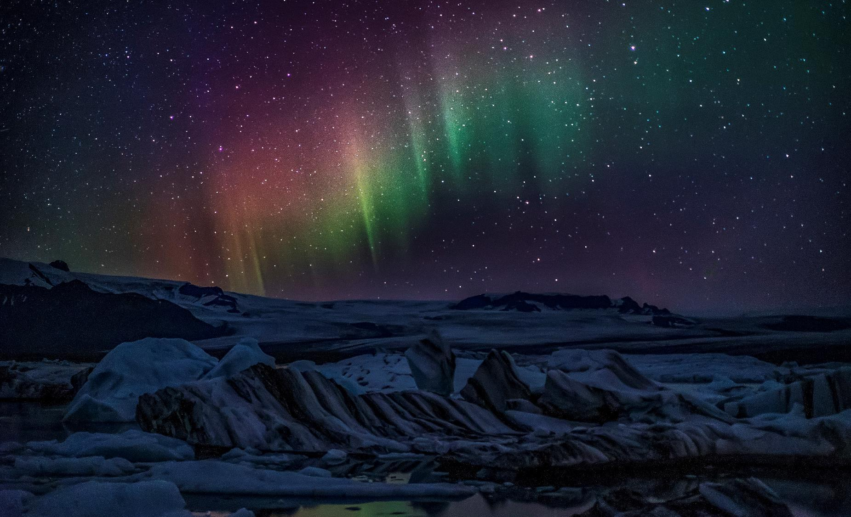
Simple Light Curve Simulator 1.0
Two Twinkle Stars

Slide 2
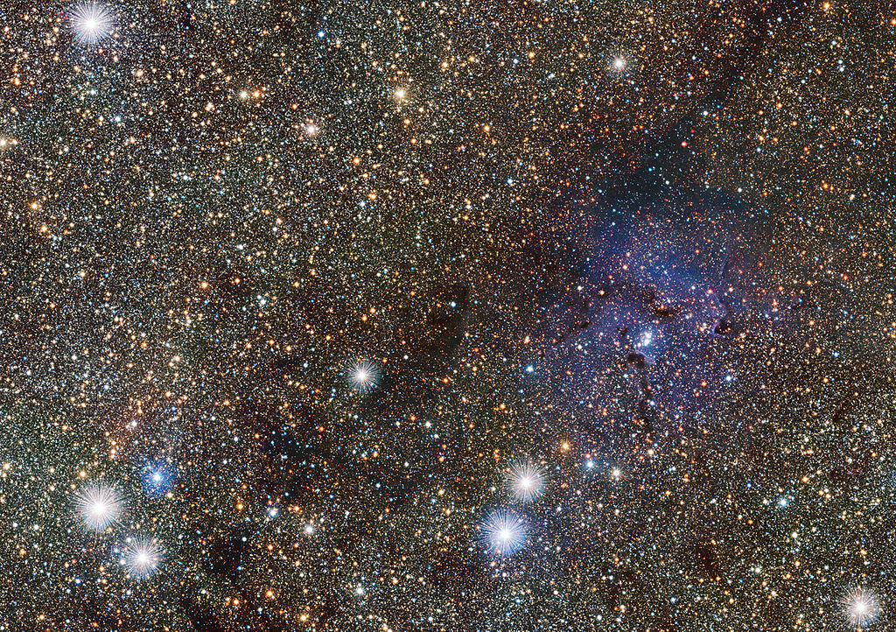
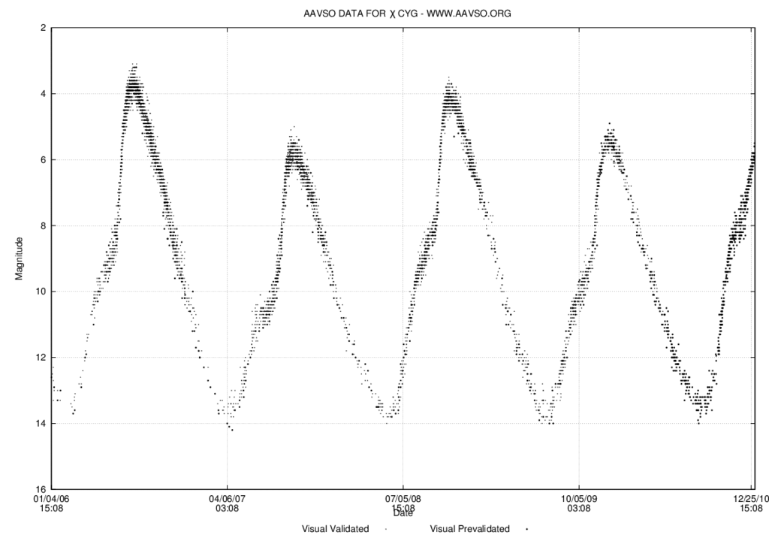
Background
Twinkling of stars we see in night sky is because of turbulence in Earth’s atmosphere. However, variability of star brightness was discovered by repeated observation of several stars in sky.
Cepheids are a type of stars whose brightness varies periodically. These variations could be:
intrinsic: pulsations, eruption or cataclysmic explosion
extrinsic: rotating variability, eclipsing binaries or planetary transit.
Light Curves gives visualization of variability in stellar brightness. This can be used to predict/compare cycles in stars of similar spectral class.
We have taken a simple case of pulsating variable star whose radius varies periodically. The simulation shows variation in brightness as stellar radius changes with time.
The Trifid Nebula contains Cepheid variable stars (ESA)
Light Curve of a variable star (Wikipedia)

Slide 3

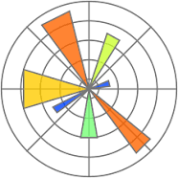





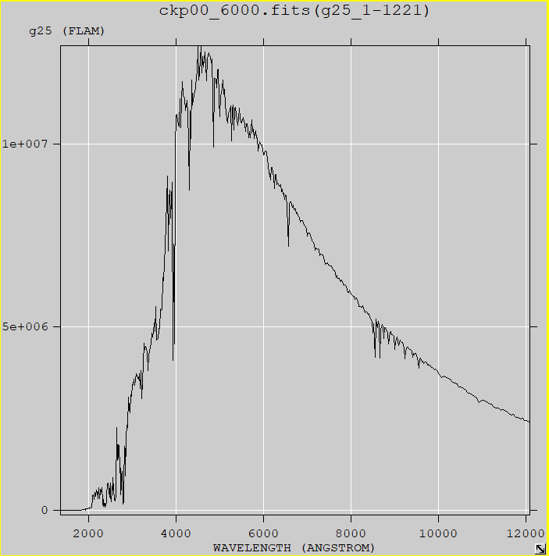
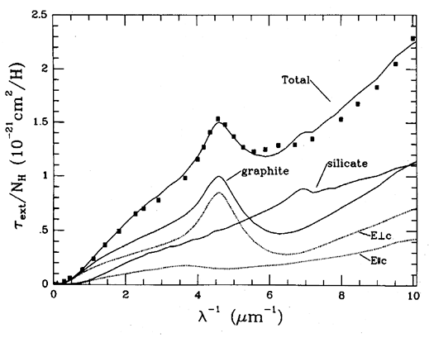
Prerequisites
Python 3
Jupyter notebook
Libraries used: numpy, pandas, astropy, matplotlib, scipy, pytest
Model Files
SED models – Castelli & Kurucz (2004)
Dust model – Draine (2003)
Vega CALSPEC spectra
Simulation Parameters
T_{eff} = 6000K , E(B-V) = 0.02 mag (fixed)
User parameters:
Radius of Star (in terms of Solar Radius)
Brightness Variation (percentage)
Distance of Star (in parsec)
Periodicity (in days)
Ndays (limit for simulation time in days)

Slide 4
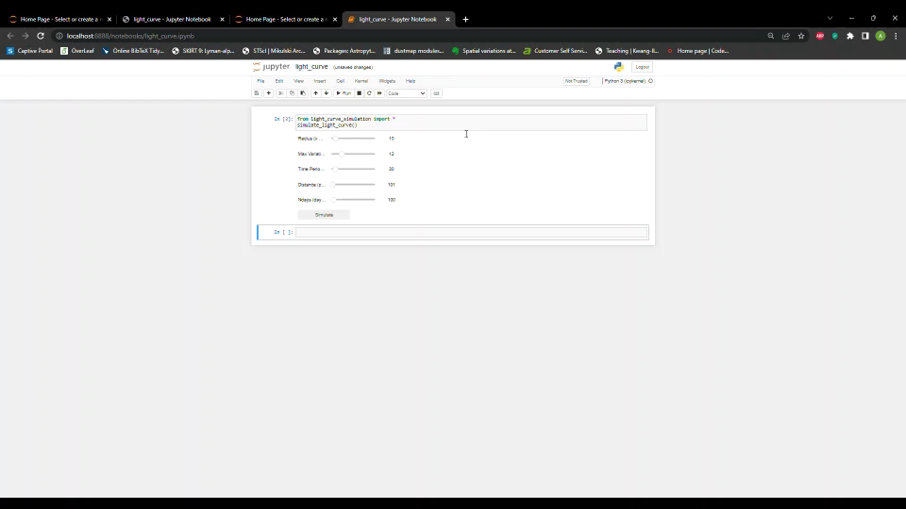
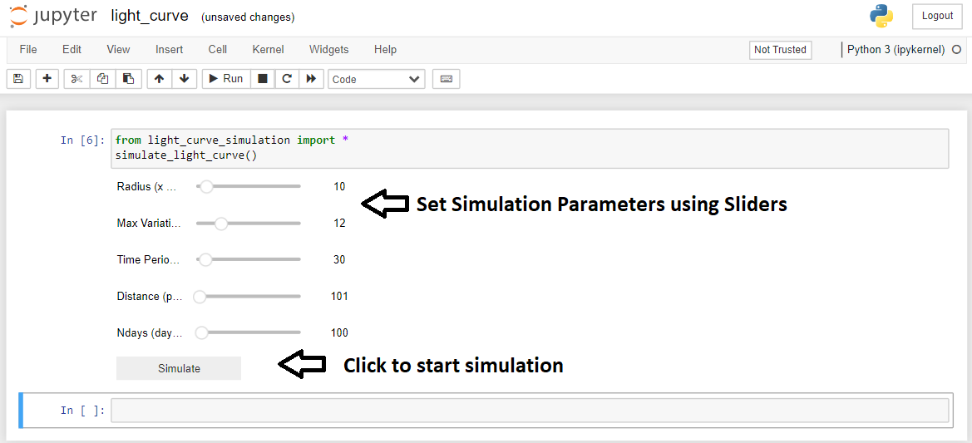
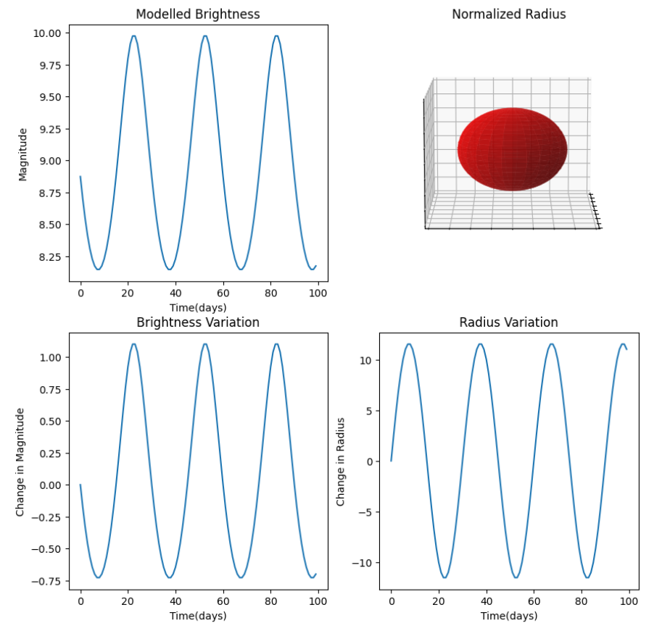
How to simulate?
Output
User inputs
Output Layout:
Modelled Brightness in magnitude as a function of time(brightness is inversely proportional to magnitude)
Normalised Radius (Shows change in radius by size, Change in brightness by opacity)
Change in magnitude as a function of time
Change in radius as a function of time

Slide 5
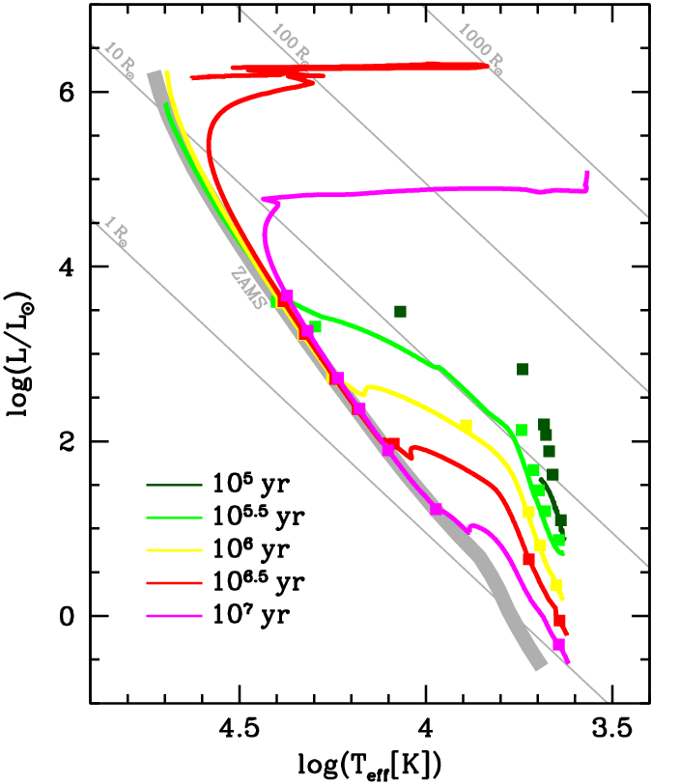
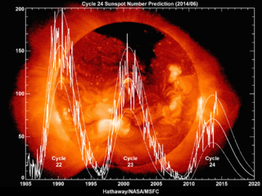
Future Work
More user capabilities:
implement grids of stellar parameter – isochrones
Varying Teff, M/H, log(g) etc.
Visualization:
Compare variation seen between two stars of similar type
Compare variation with that of Sun.
Math Modelling:
Current version (1.0) is basic and simple
Include real data and fitted function to simulate dynamics of variable stars

Slide 6


